Slide 1
Logs Analysis
Sept 4, 2023
Lovi Singh

Slide 2
Content
Problem Statement
Solution
Docker
ElasticSearch
Kibana
Zookeeper
Kafka
Kafka-Manager
DashBoard

Slide 3
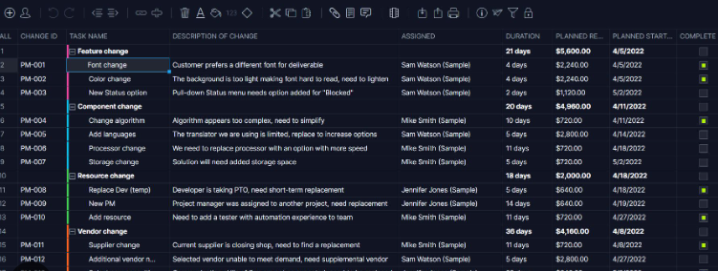
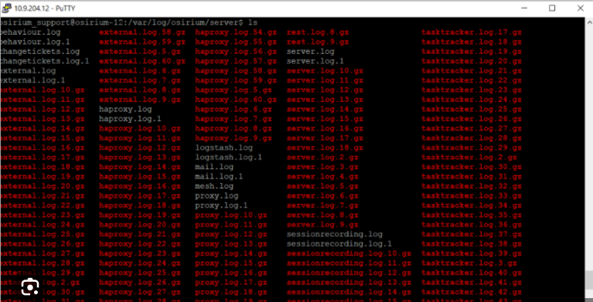
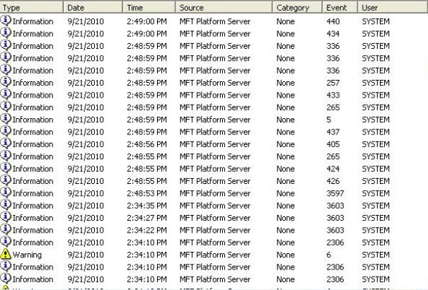
Why Logs Are Important?!
Application Monitoring
Security Analysis
Troubleshooting
Different types of Logs

Slide 4
Problem Statement
Client needs a working POC to visualise logs in real time. You have to work upon a use case which generates logs infinitely in the format provided below, process the same in real time using Kafka and analyse it on Elastic search.
PAM logs:
Jul 7 10:51:24 srbarriga su(pam_unix)[14592]: session opened for user test2 by (uid=10101)
Jul 7 10:52:14 srbarriga sshd(pam_unix)[17365]: session opened for user test by (uid=508)

Slide 5
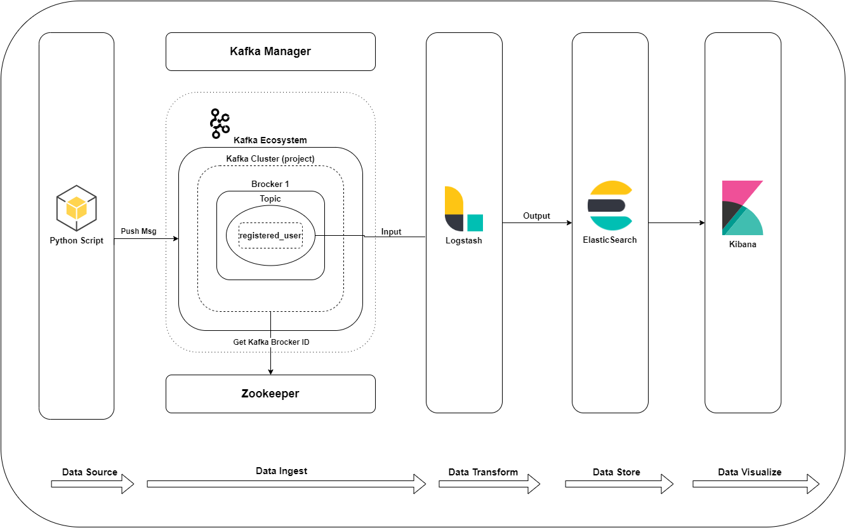
Solution
List of Services/Tools used :
Kafka
Zookeeper
Logstash
ElasticSearch
Kibana

Slide 6
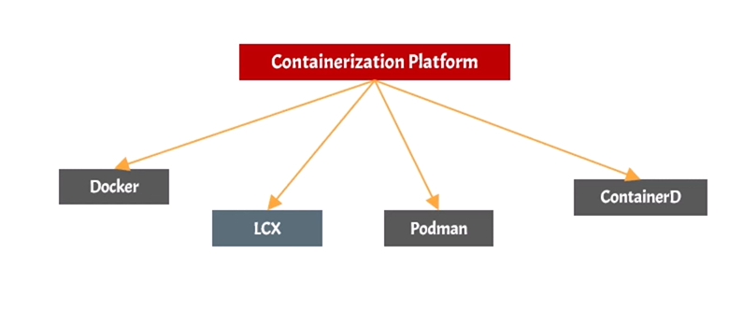
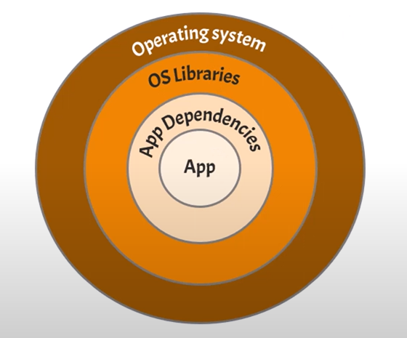
Docker
Docker is a technology that allows you to build, run,
test, and deploy distributed applications.
It uses operating-system-level virtualization to
deliver software in packages called containers.
It packages an application with all its dependencies
into a standard unit.
It eliminates the friction between development,
QA and production environment.

Slide 7
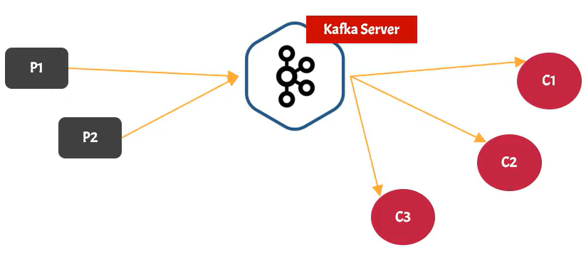
Kafka
Apache Kafka is a distributed publish-subscribe messaging system and a robust queue that can handle a high volume of data and enables you to pass messages from one end-point to another.
It is just like messaging system.
It is fault-tolerant.
It is distributed platform / application
In production environment Kafka is referred
as Kafka Cluster.
A cluster is made up of more than one
Kafka Server.
Each Kafka server Is referred as Broker.

Slide 8
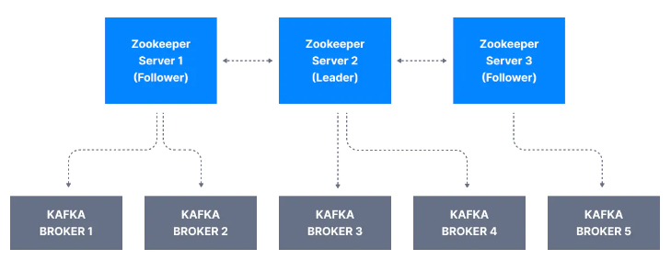
Zookeeper
ZooKeeper is a centralized service for maintaining configuration information, naming, providing distributed synchronization, and providing group services.
Zookeeper keeps track of which brokers are part
of the kafka cluster.
Zookeeper is used by kafka brokers to determine
which broker is the leader of a given partition
and topic and perform leader elections.

Slide 9
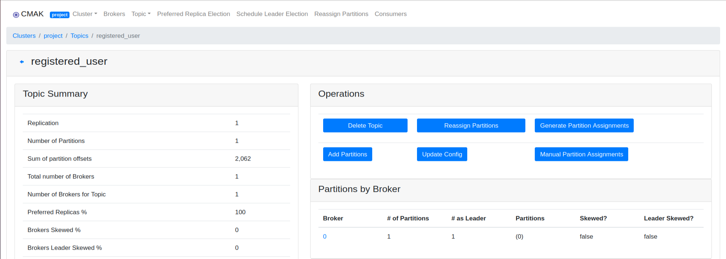
Kafka Manager
It is an open-source managing tool for Apache Kafka Cluster.
With Kafka Manager we can manage multiple cluster.
Easy inspection of cluster
state ( topic, consumers,
offsets, brokers, replica
distribution, partition
distribution )
Run preferred replica
election.

Slide 10
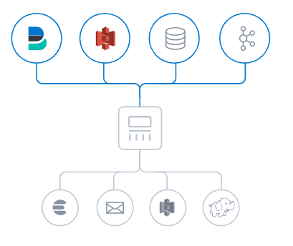
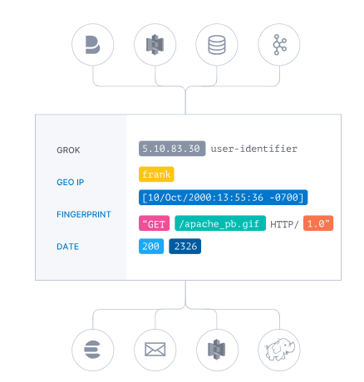
Logstash
Logstash is a free and open server-side data processing pipeline that ingests data from a multitude of sources, transforms it, and then sends it to your favorite "stash.“
Inputs, filters & outputs
Ingest data of all shapes, sizes, and sources
Parse & transform your data on the fly

Slide 11
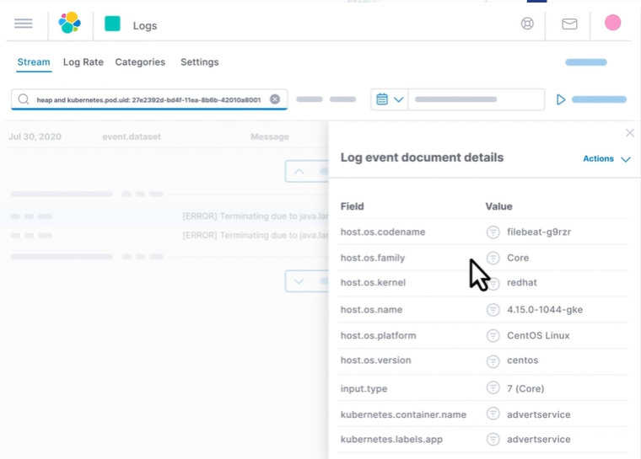
ElasticSearch
Elasticsearch is the distributed search and analytics engine at the heart of the Elastic Stack.
Elasticsearch provides near real-time search and analytics for all types of data.
Whether you have structured or unstructured text, numerical data, or geospatial data, Elasticsearch can efficiently store and index it in a way that
supports fast searches.

Slide 12
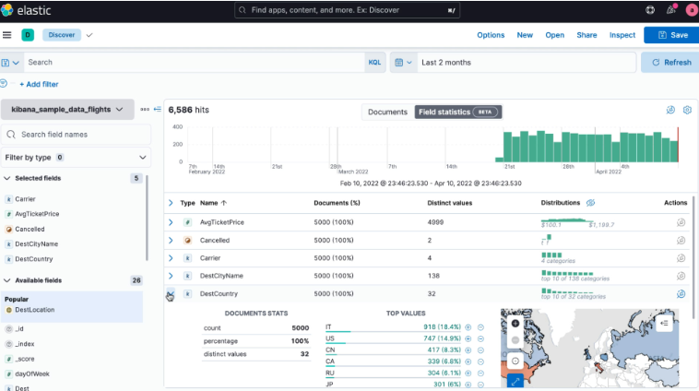
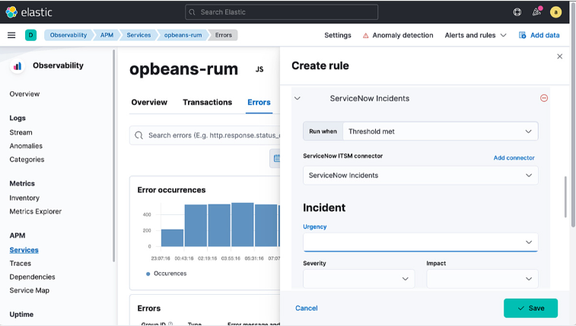
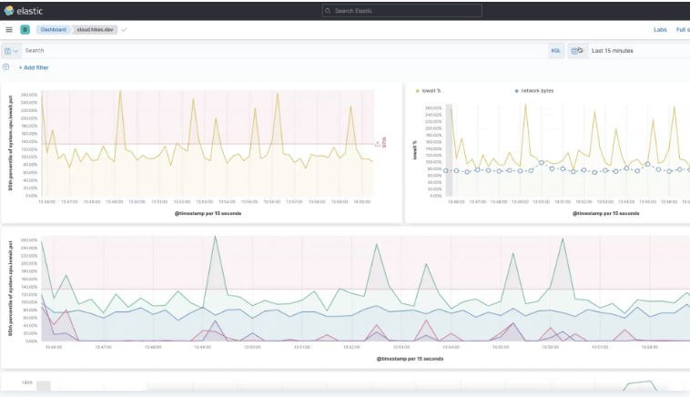
Kibana
Kibana is a data visualization and exploration tool used for log and time-series analytics, application monitoring, and operational intelligence use cases.
The core feature of Kibana is data querying & analysis.
Faster analytics, faster solutions.
Monitor and take action on alerts.
Run time series to find similarities.

Slide 13
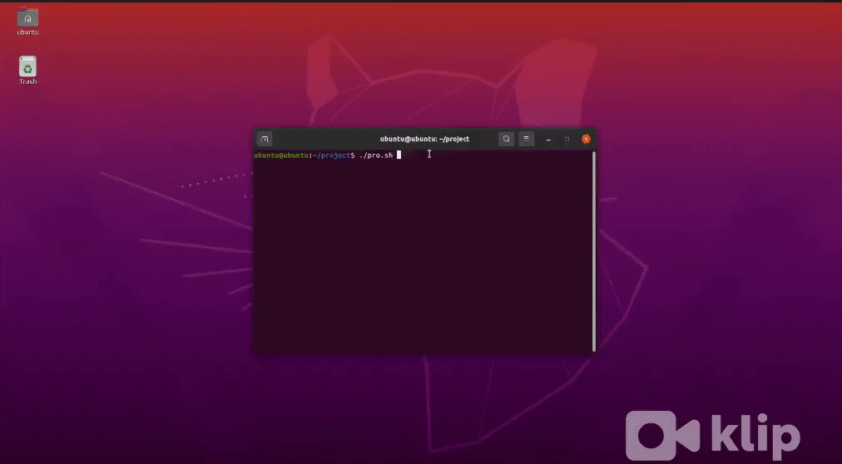
Working
A single bash file “pro.sh” to run all the services

Slide 14
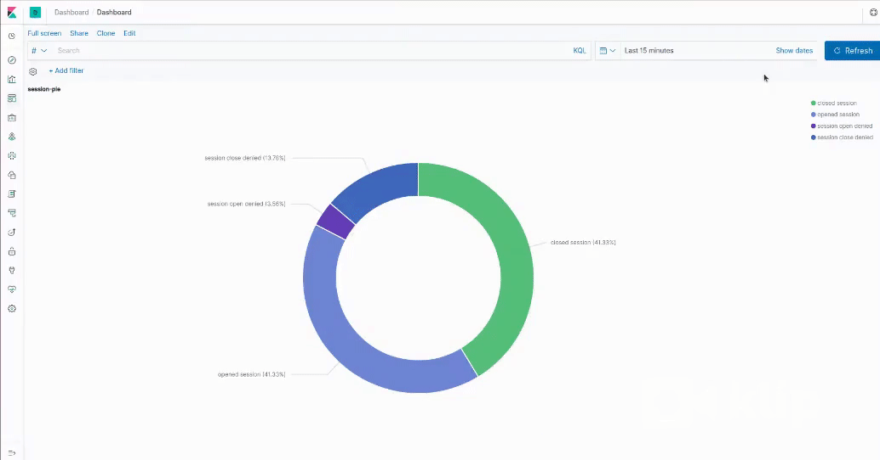
Visualizing data
The Session info.

Slide 15
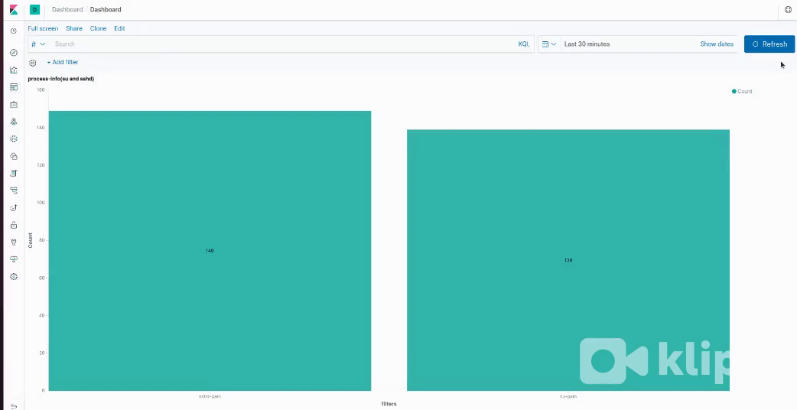
Visualizing data
The process info.

Slide 16
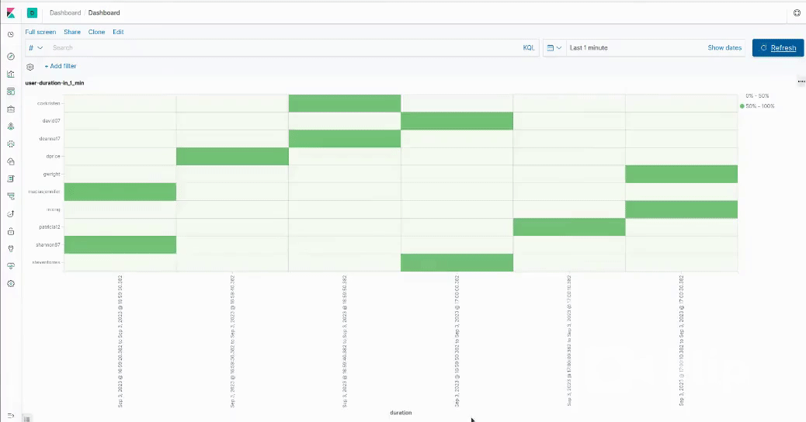
Visualizing data
The user who generated logs for a particular duration.

Slide 17
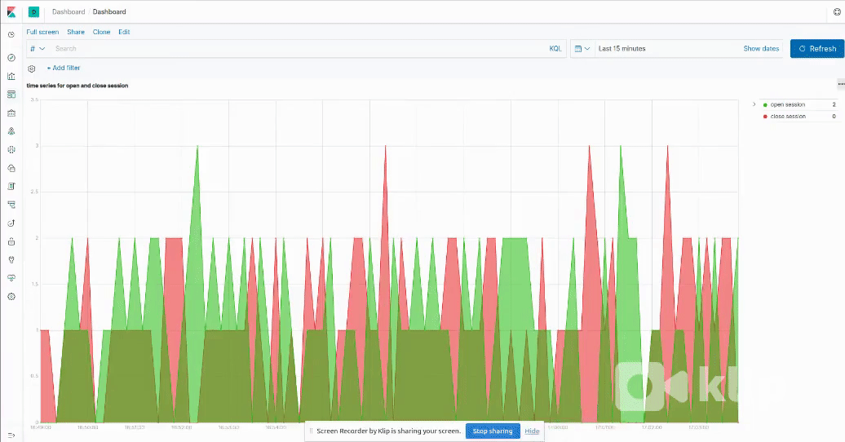
Visualizing data
Time Series for open and close session.

Slide 18
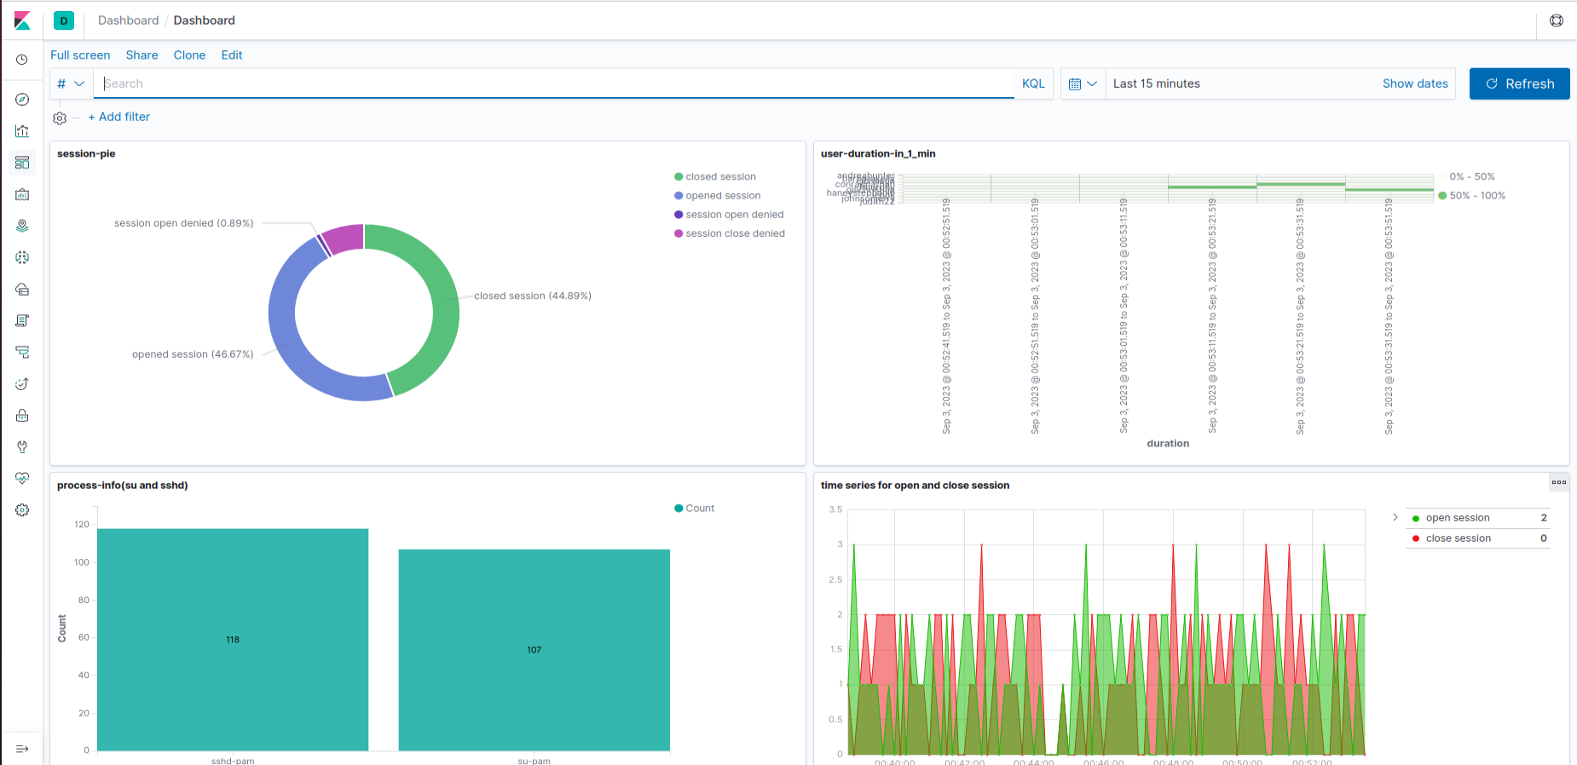
Dashboard

Slide 19
Thank You

